Slide 1
RACK MANAGEMENT SYSTEM
Presented by :VINITHA.M Mentor:Dr.MANJAIAH D.H

Slide 2
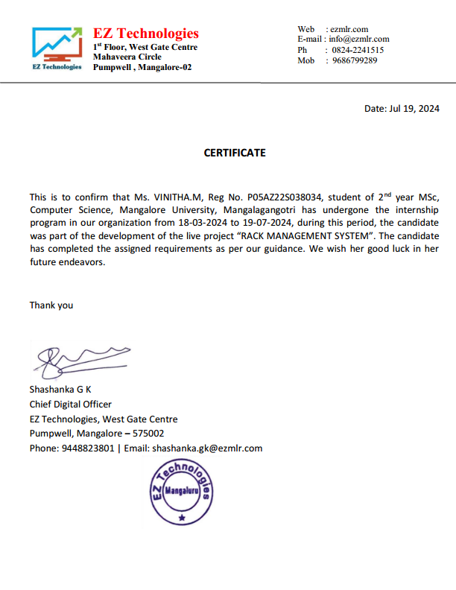
INTERNSHIP CERTIFICATE

Slide 3
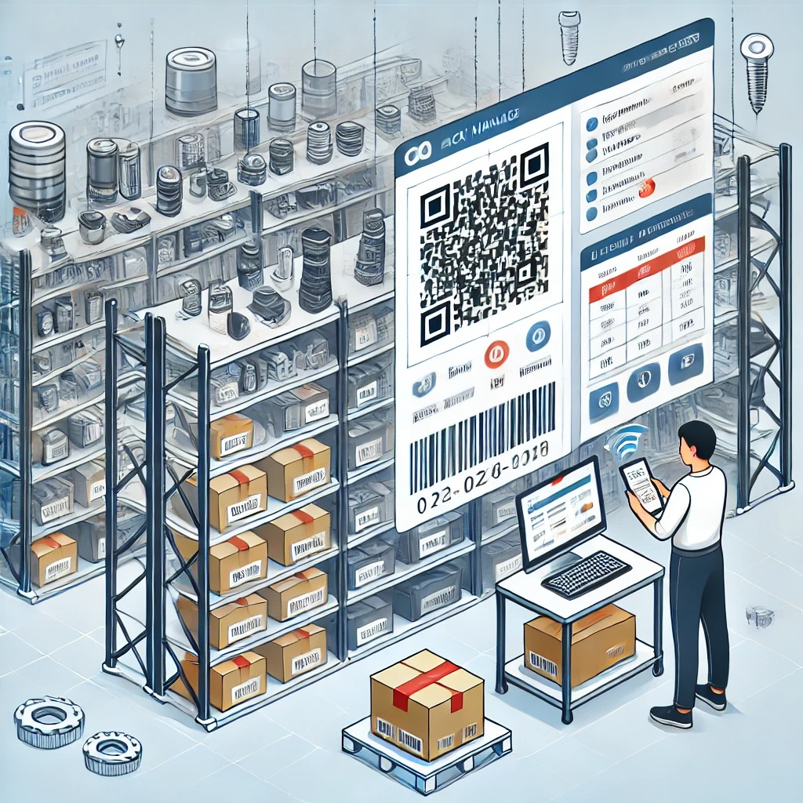
INTRODUCTION
Rack Management system, an innovative platform developed for BREVERA TECHNOLOGIES, is designed to streamline workflow and enhance efficiency in managing stock processes digitally
This platform is particularly developed for managing items such as capacitors, resistors, screws, and other electronic and non-electronic components which will be placed in the item warehouse located in Mysore and later all the components are used to make an electronic product and will be supplied to their customers based on orders.

Slide 4
What It Is :
Comprehensive Inventory Management : The Rack Management System is designed to handle all aspects of inventory management, from item entry and quality checks to organization and retrieval.
Real-Time Tracking : It provides real-time visibility into inventory levels and locations, allowing for accurate monitoring and management of stock.
Automated Data Entry : Utilizes QR code scanning and AWS Textract to automatically capture and input item information, reducing manual data entry and associated errors.
Quality Control: Automatically checks items to make sure they meet set standards before they are added to inventory.
Mobile Accessibility: Can use phone or laptop to manage inventory from anywhere.
Enhanced Organization: Recommends the best bin locations for items to keep things organized and easy to find.

Slide 5
Why It Matters:
Reduces Manual Work: Automates routine tasks like data entry and stock tracking, freeing up time for staff to focus on more strategic activities.
Saves Time: Streamlines inventory management processes, leading to faster handling of stock and quicker access to information.
Prevents Stockouts and Overstocks: Provides real-time insights and alerts to avoid running out of stock or having excess inventory, leading to better stock level management.
Improves Customer Satisfaction: Ensures that inventory is well-organized and readily available, leading to faster fulfillment and better service for customers.
Supports Growth: Scales with the business, making it easier to handle more inventory as it expands.

Slide 6
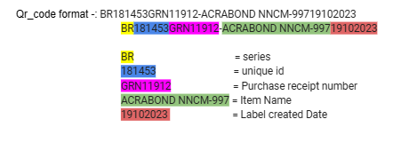
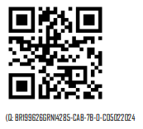
Key Features:
QR Code Scanning: Quickly capture and store item information.

Slide 7
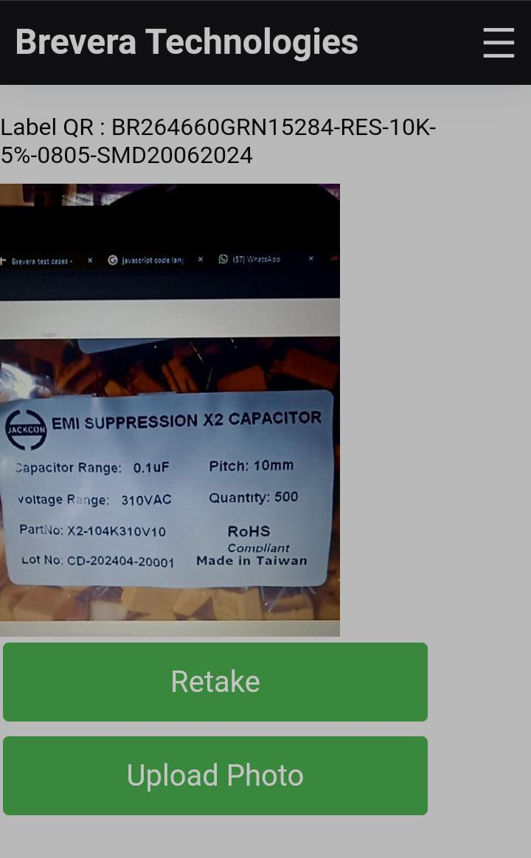
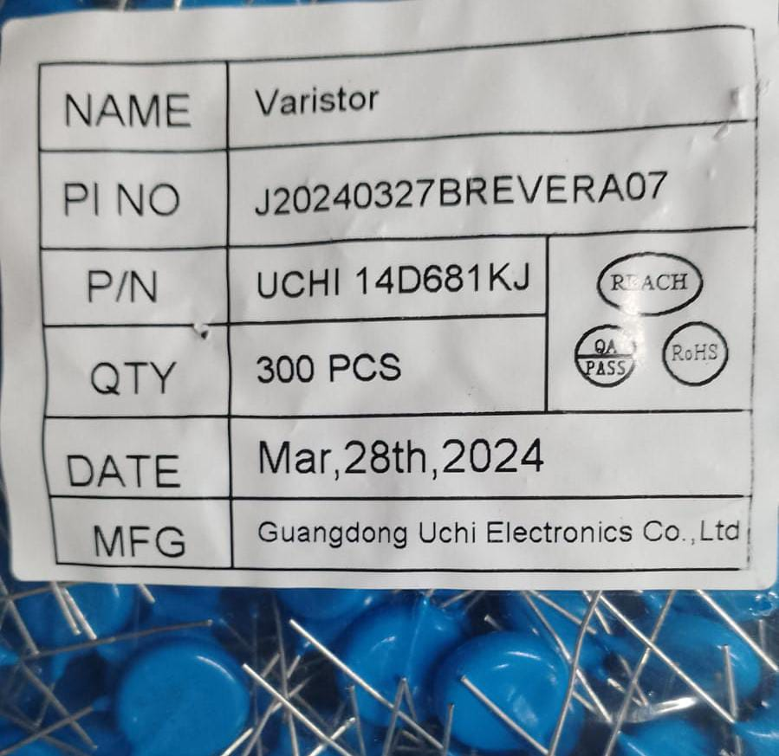
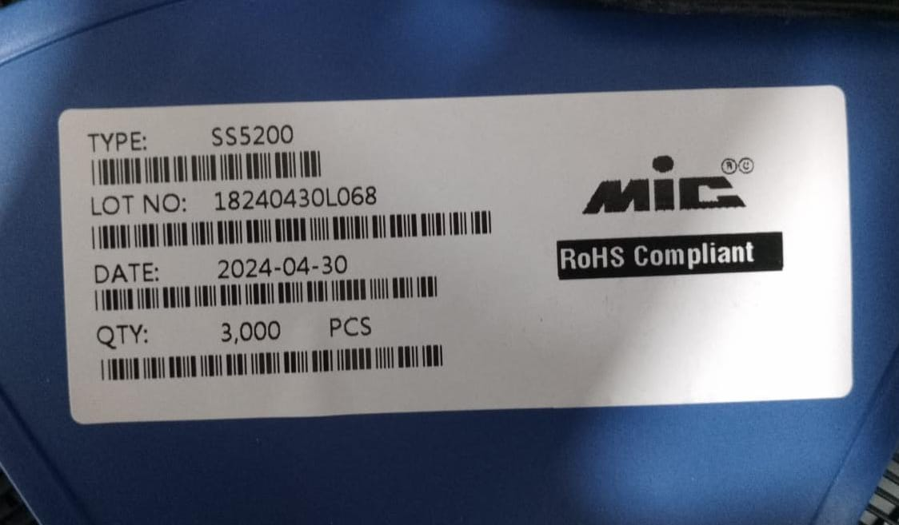
Label Capturing:
Label Capturing : For each QR code, the system extracts specific data such as make, part number, quantity, and date from the label.

Slide 8
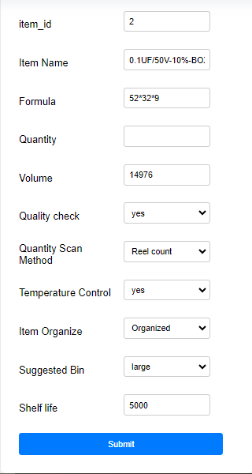
ERP Integration (Enterprise Resource Planning) :
Enterprise resource planning (ERP) is a software system that helps businesses manage their day-to-day activities and processes. In these system ERP is used for :
ERP is used for fetching item details to generate qrcode
And also to check the supplied item vendor is genuine or not
Brevera System
ERP
Item details

Slide 9


Mobile Access:
Mobile Access: Manage stock from anywhere using your phone or laptop.

Slide 10
Bin Management:
Bin Management: Suggests optimal bin locations for each item to keep inventory organized and easily accessible.
Formulas for Different Bin Sizes
The system uses specific formulas to determine bin sizes:
Bin Size | Formula in CM | Formula in MM
Small | 58 * 38.5 * 19 | 600 * 400 * 200
Medium | 58 * 39 * 24 | 615 * 425 * 250
Large | 57 * 37 * 33 | 600 * 400 * 340

Slide 11
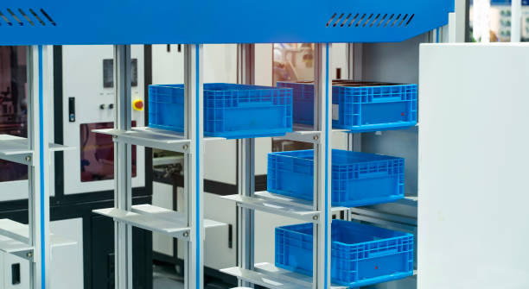
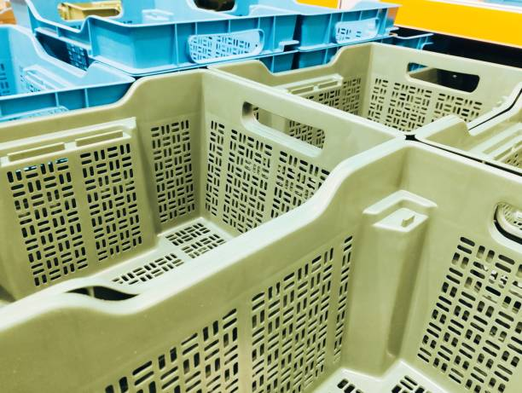
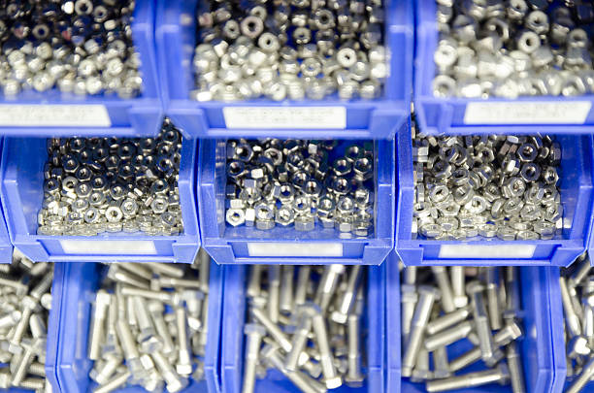
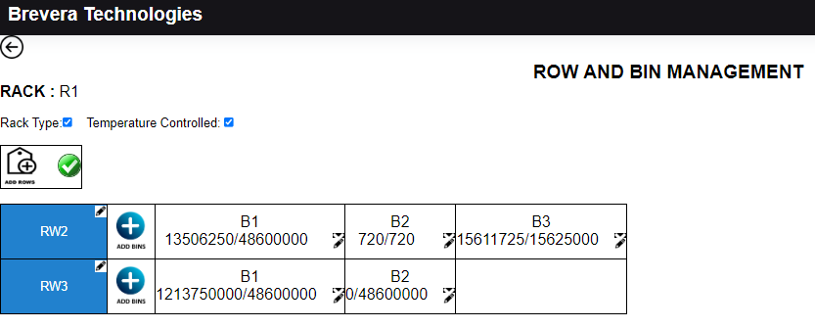

Slide 12
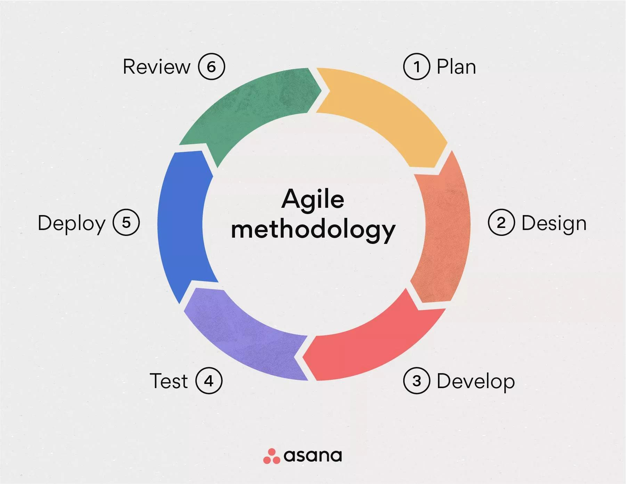
METHODOLOGY :
In this project we follow up project management methodology that Is “Agile methodology ”.
In the Agile method, it supports iterative development, focus on continuous improvement., and flexibility—key factors in building an effective and efficient system.
Agile software phase is characterized in a manner that addresses several key
1. It is difficult to think in advance which software requirements will persist and which will change. It is equally difficult to predict how user priorities will change as the project proceeds.
2. It is difficult to think about how much design is necessary before construction is used to test the configuration.

Slide 13
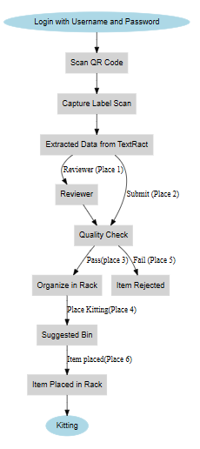
How It Works:
Data Entry:
Step 1: Scan the item's QR Code.
Action: Perform Label Capturing to extract specific data such as make, part number, quantity, and date.
Review:
Step 2: Place the item in Place 1.
Action: Conduct a Review of the captured data.
Quality Control (QC):
Step 3: Move the item to Place 2.
Action: Perform Quality Control (QC) checks on the item.
Rack Organize:
Step 4: Transfer the item to Place 3.
Action: Organize the item in the designated Rack (Place RO).
Kitting:
Step 5: Place the item in Place 4.
Action: Assemble or Kit the item with other necessary components.
Rejected:
Step 6: If the item fails QC or any other criteria, move it to Place 5.
Action: Mark the item as Rejected.

Slide 14
Places for Each Process
The Rack Management System organizes various processes in specific locations:
Process | Place | Description
Review | Place 1 | Place Review
QC | Place 2 | Place QC
Rack Organize | Place 3 | Place RO
Kitting | Place 4 | Place Kitting
Rejected | Place 5 | Item Rejected
Placed | Place 6 | Item placed in rack
Table: The organization of rack management system

Slide 15
1. DATA ENTRY:
STEP 1 : LOGIN USING USERNAME AND PASSWORD
STEP2 : QR CODE SCANNING
STEP3 : LABEL CAPTURING
STEP4: EXTRACTED DATA FROM TEXTRACT
STEP5 : SUBMIT OR REVIEW THE ITEMS

Slide 16
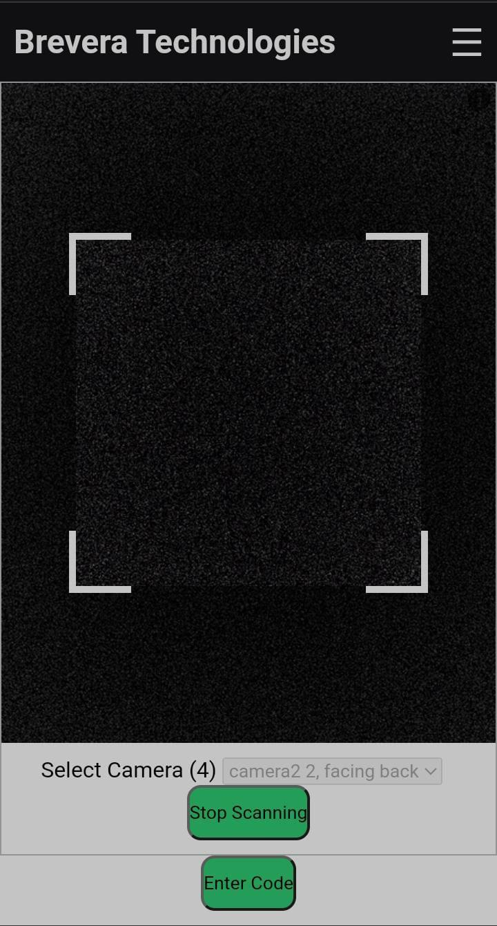
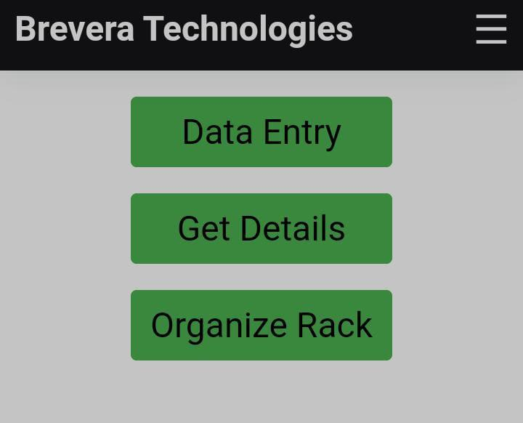
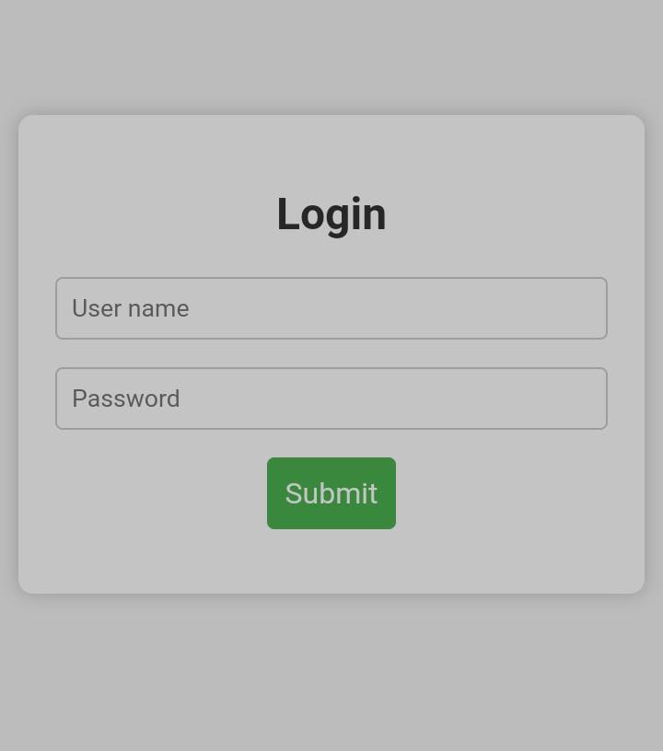
1.LOGIN USING USERNAME AND PASSWORD
2.DASHBOARD PAGE
3.QR CODE SCANNING

Slide 17
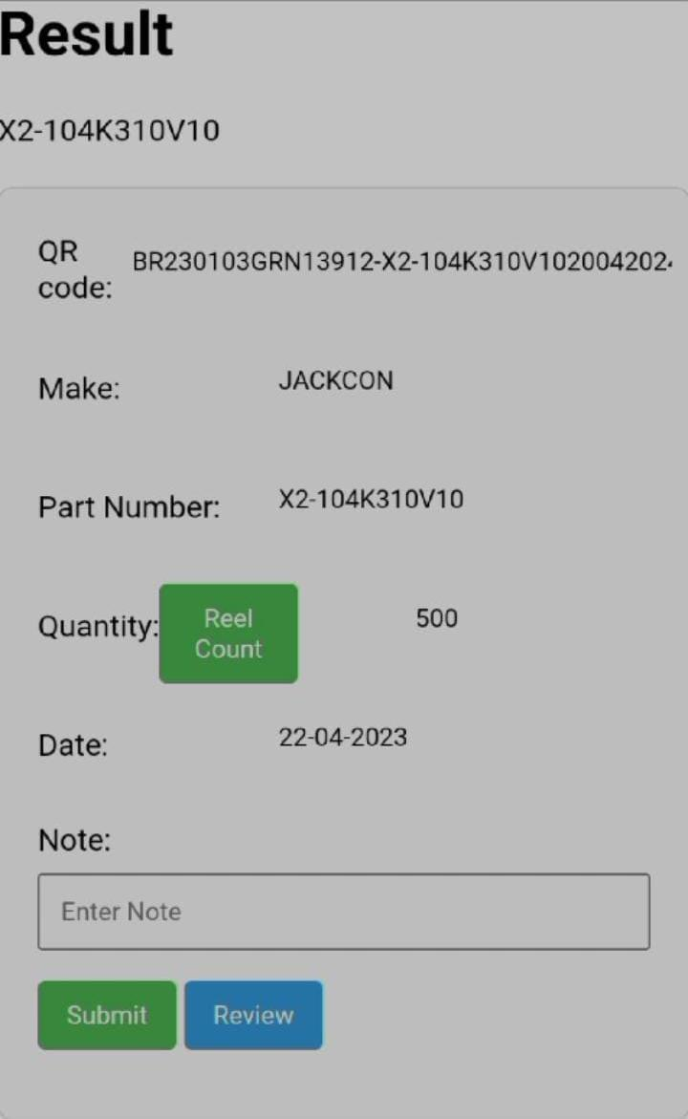
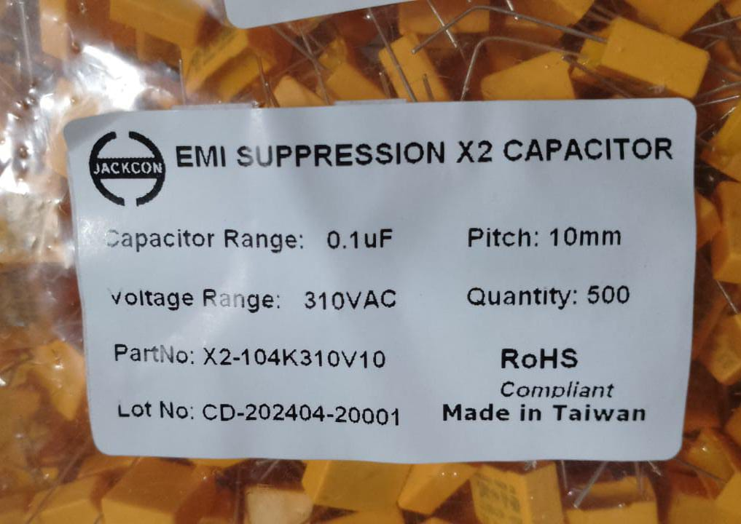
EXTRACTED DATA FROM TEXTRACT : Item stickers with their details are uploaded to AWS Textract, which extracts all the text from the image. Then, pattern matching is used to retrieve only the four required pieces of data.

Slide 18
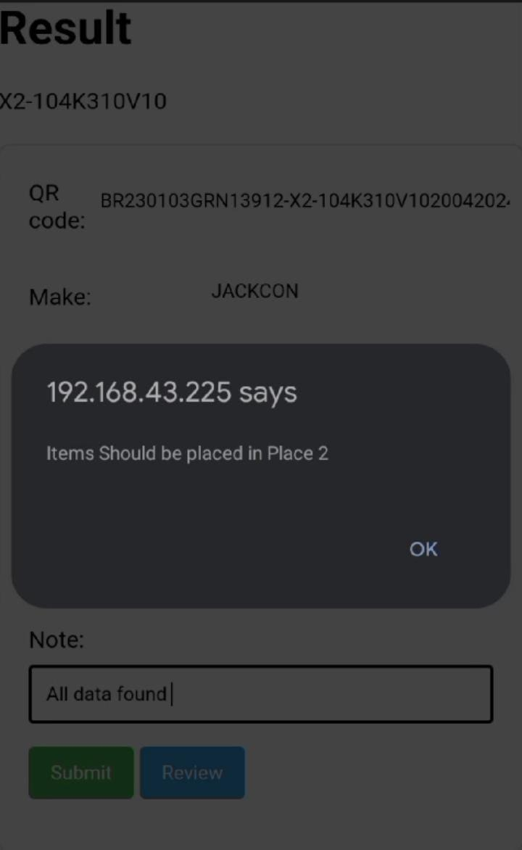
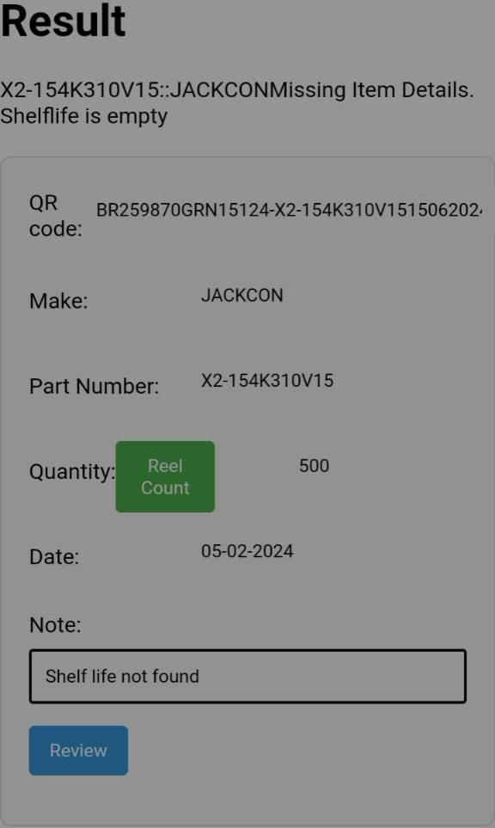
SUBMIT OR REVIEW THE ITEMS

Slide 19
2.REVIEW
STEP 1 : LOGINING TO REVIEW
STEP 2 : REVIEW LIST
STEP 3 : FILL THE DETAILS (An alert will pop up if any details are missing.)
STEP 4 : EXPIRED ITEM SHOULD BE ACCEPT OR REJECT
STEP 5 : RECORD UPDATED

Slide 20
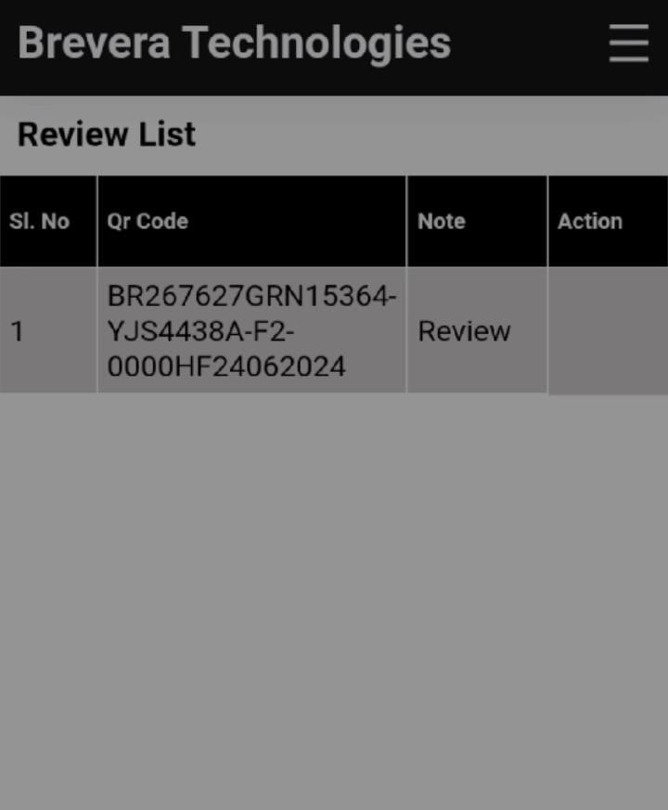
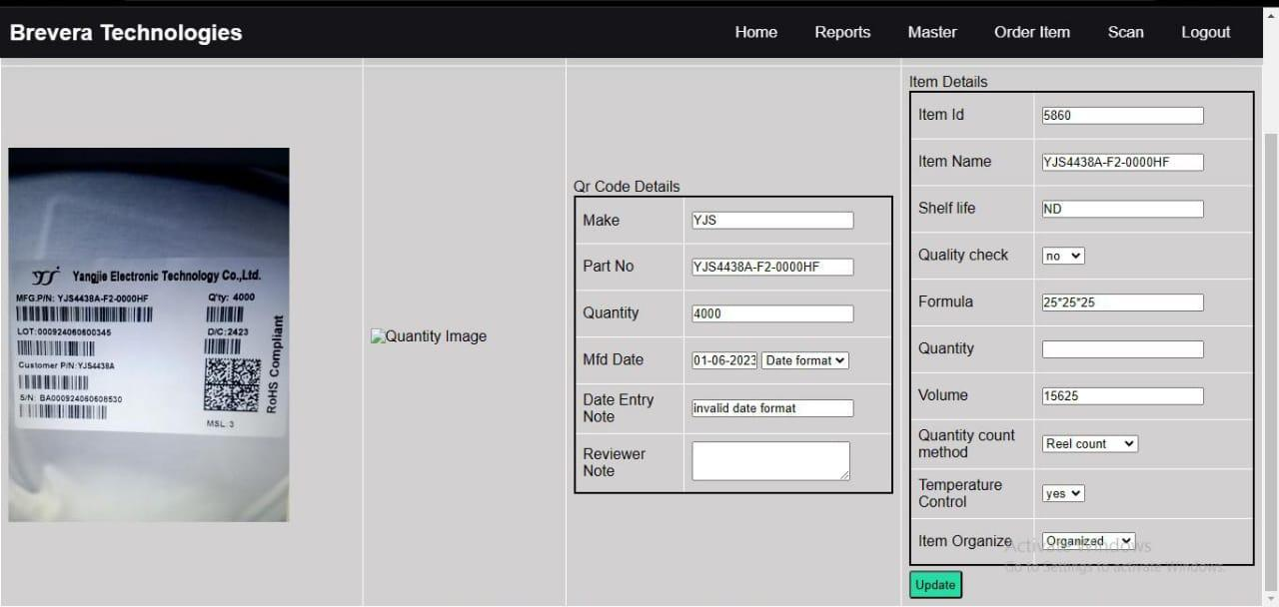
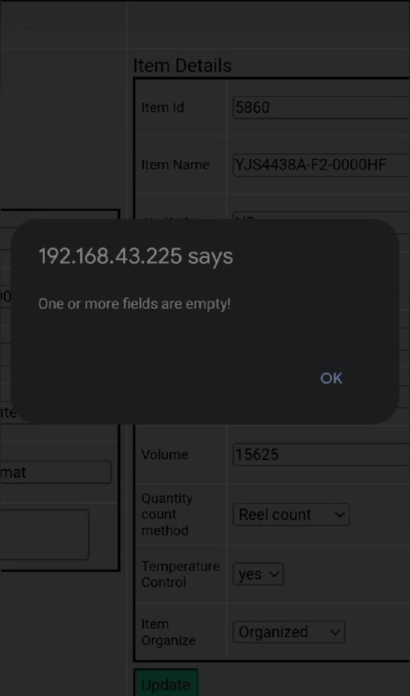
REVIEW LIST
FILL THE DETAILS
FILL THE DETAILS

Slide 21
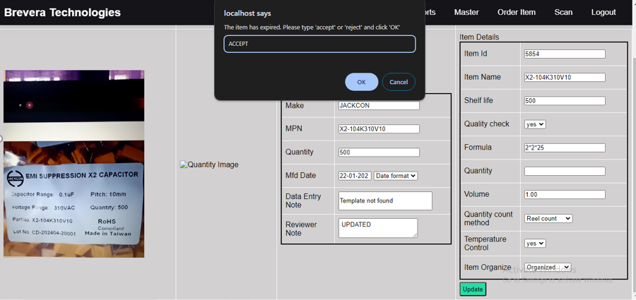
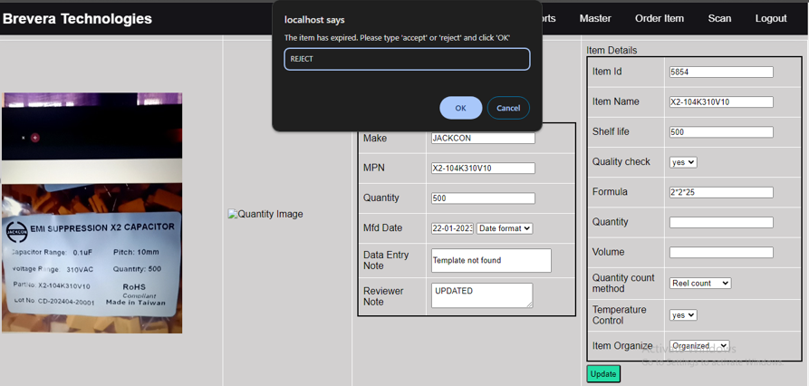
EXPIRED ITEM SHOULD BE ACCEPT OR REJECT

Slide 22
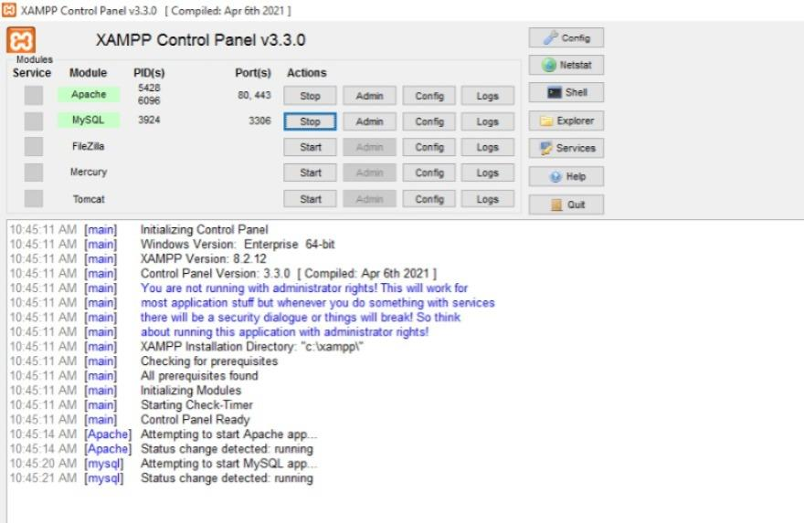
XAMPP CONTROL PANEL :

Slide 23
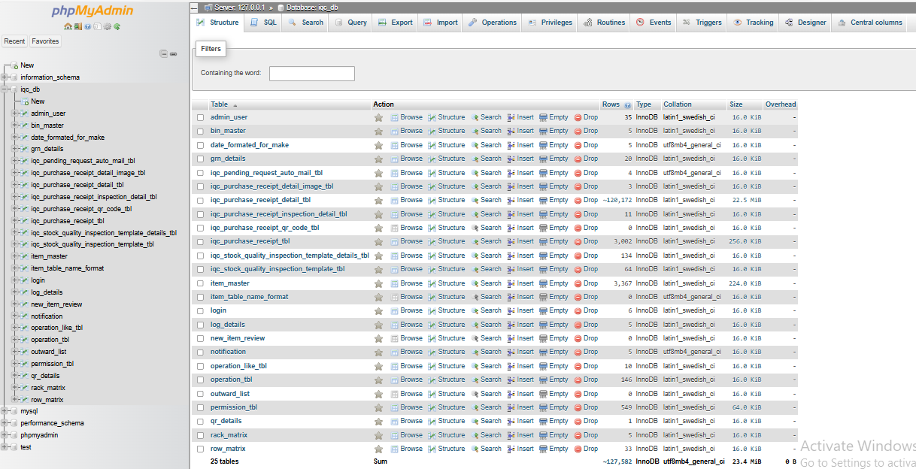
DATABASE :
XAMPP helps a local host or server to test its website and clients via computers and laptops before releasing it to the main server. It is a platform that furnishes a suitable environment to test and verify the working of projects based on Apache, Perl, MySQL database, and PHP through the system of the host itself

Slide 24
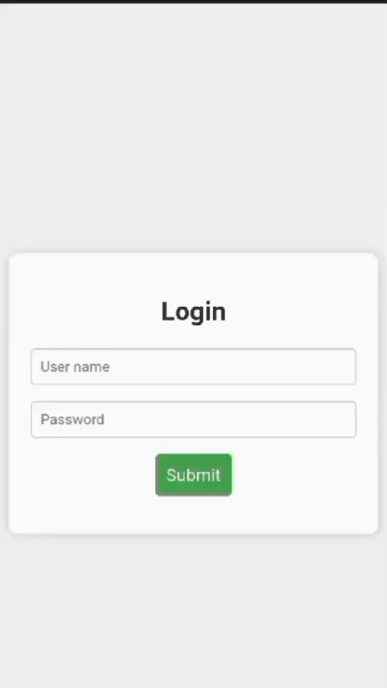
DEMO VIDE0 DATA ENTRY :

Slide 25
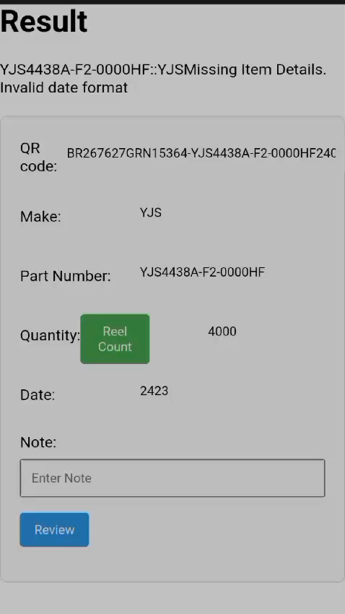
REVIEW :

Slide 26
CONCLUSION AND FUTURE WORK SCOPE :
The Rack Management System offers an effective way to manage inventory and improve storage processes.
By automating key tasks, it reduces the need for manual work and paperwork, leading to better accuracy and efficiency.
Features like real-time tracking, quality control, and ERP integration help minimize errors and downtime.
Overall, this system makes inventory management easier, boosts productivity, and supports business growth.

Slide 27
FUTURE WORKS:
Future work for the Rack Management System will focus on enhancing functionality and performance.
The system will also see scalability improvements through cloud integration and user-friendly updates like a mobile app and customizable dashboards
Enhanced security features will include role-based access control and audit

Slide 28
THANK YOU

